Slide 1
Cloud Based Data Engineering
Lecture 9: Recommendation Systems

Slide 2
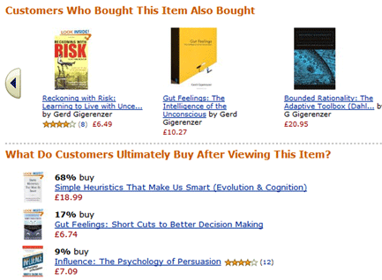
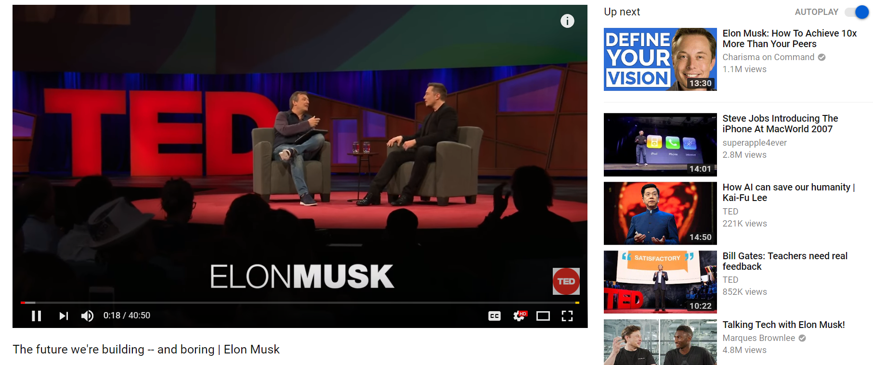
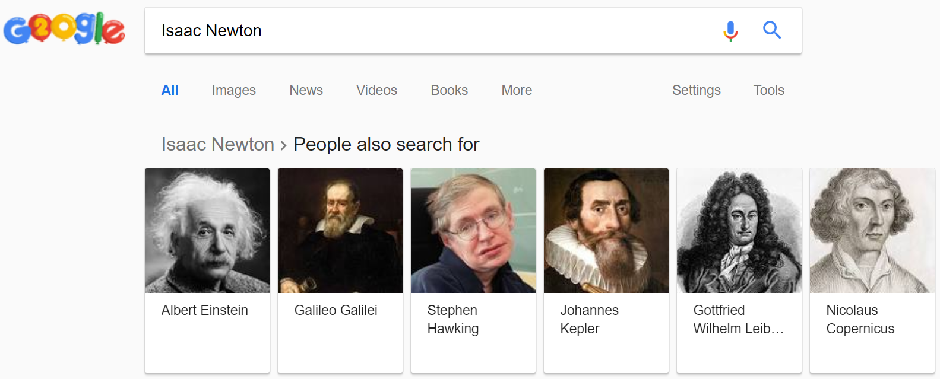
Recommender Systems
A recommender system (RS) helps users that have no sufficient competence or time to evaluate the, potentially overwhelming, number of alternatives offered by a web site. In their simplest form, RSs recommend to their users personalized and ranked lists of items

Slide 3
The Impact of Recommendation Systems
35% of the purchases on Amazon are the result of their recommender system.
Recommendations are responsible for 70% of the time people spend watching videos on YouTube.
75% of what people are watching on Netflix comes from recommendations, according to McKinsey

Slide 4

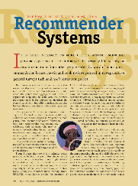

The Rise of the Recommender System
*

Slide 5



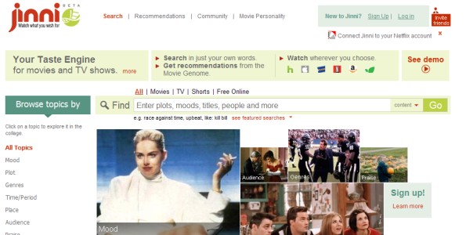
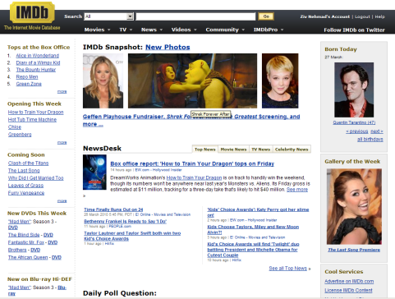



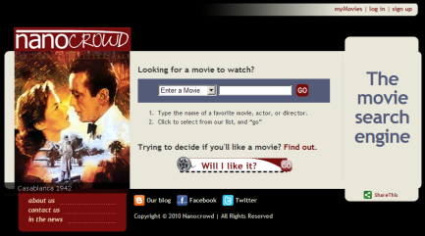
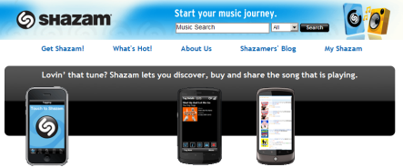





Recommendation Models
Model | Commonness | Used By:
 |  | Jinni | Taste Kid | Nanocrowd | Clerkdogs | Criticker | IMDb | Flixster | Movielens | Netflix | Shazam | Pandora | LastFM | YooChoose | Think Analytics | Itunes | Amazon
Collaborative Filtering |  | v |  |  |  | v | v | v | v | v | v |  | v | v | v | v | v
Content-Based Techniques |  | v | v | v | v |  | v |  | v |  |  | v | v | v | v |  | v
Knowledge-Based Techniques |  | v | v | v | v |  | v |  |  |  |  | v |  |  | v
Stereotype-Based Recommender Systems |  | v | v | v | v |  | v |  |  |  |  |  |  | v | v
Ontologies and Semantic Web Technologies for Recommender Systems |  | v |  | v |  |  |  |  |  |  |  | v
Community Based Recommender Systems |  | v |  | v |  | v |  |  | v | v |  |  |  | v | v
Demographic Based Recommender Systems |  |  |  |  |  |  |  |  |  | v
Context Aware Recommender Systems |  | v |  | v | v | v |  |  |  |  |  |  |  | v | v
Conversational/Critiquing Recommender Systems |  | v |  |  |  |  |  |  |  |  |  |  |  |  | v
Hybrid Techniques |  | v |  |  |  |  |  | v |  | v | v |  | v

Slide 6
Challenges
Cold start / Data sparsity
Collaborative filtering methods recommend items based on users’ past preferences
New users will need to rate several items to enable the system to capture their preferences accurately
For new systems, the initial state is an empty dataset

Slide 7
Challenges
“Gray sheep”
Refers to the users whose opinions do not consistently agree or disagree
with any group of people, and thus do not benefit from collaborative filtering.
Scalability
As the numbers of users and items grow, traditional CF algorithms will suffer
serious scalability problems.

Slide 8
The Netflix Problem
The Netflix problem was introduced in 2006
Hundreds of thousands of users across thousands of movies
Predict user rating (1-5)
Many missing data = sparse matrix (a lot of missing values or zeros)

Slide 9
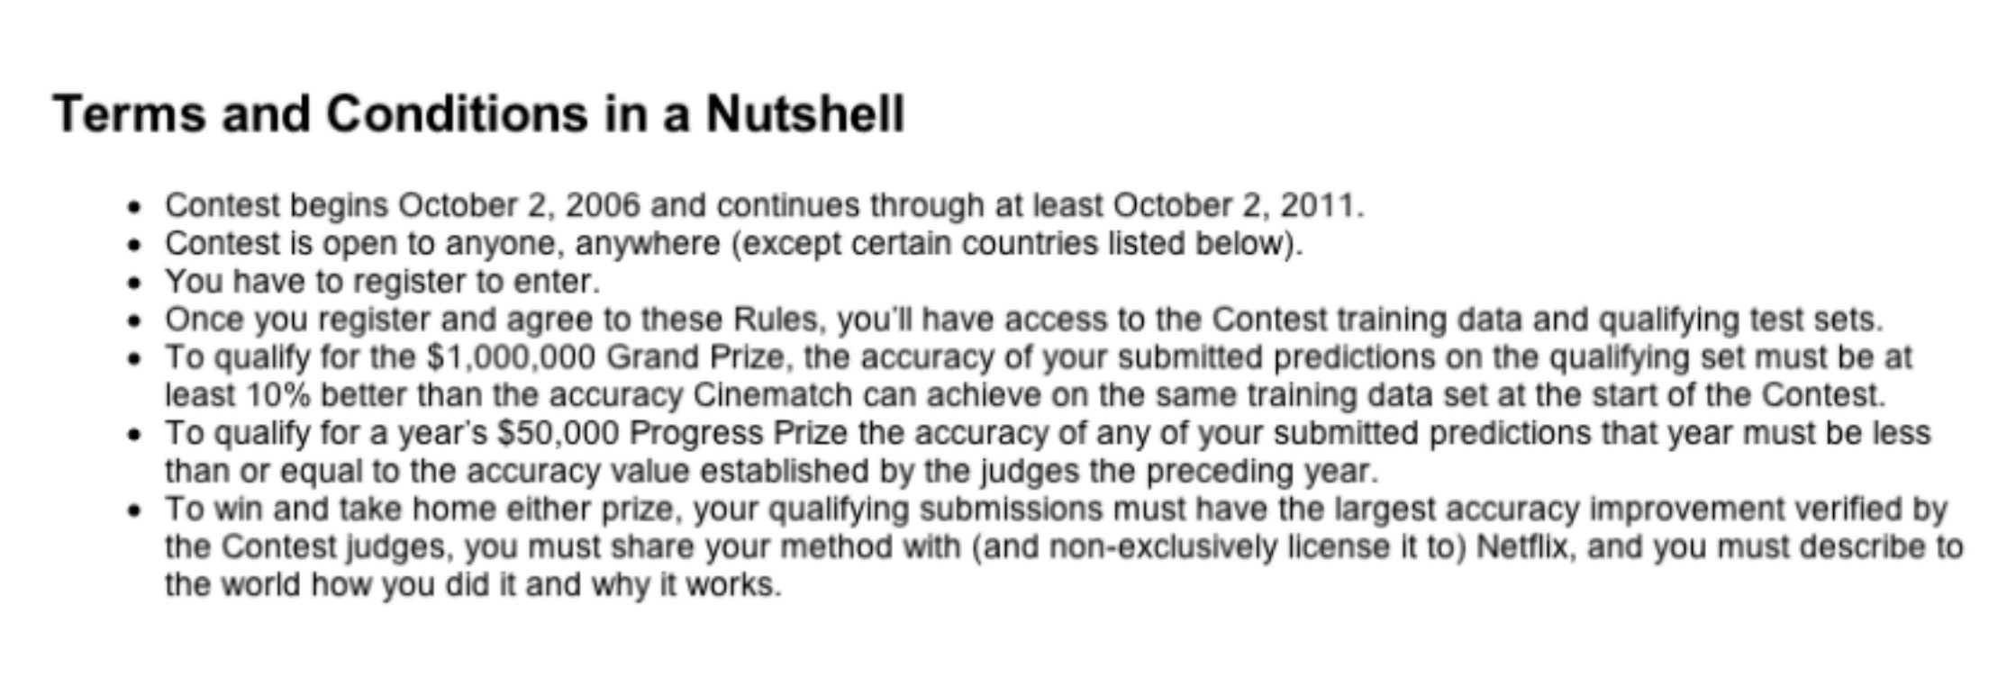

The Netflix Problem - Rules
https://en.wikipedia.org/wiki/Netflix_Prize

Slide 10
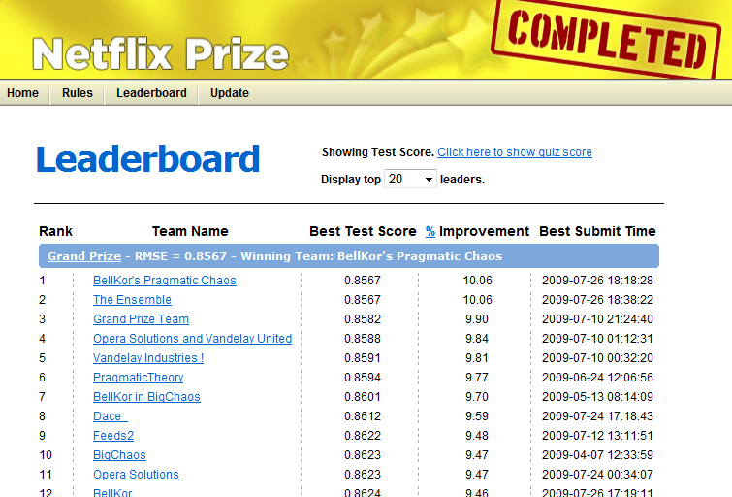
20 min later

Slide 11
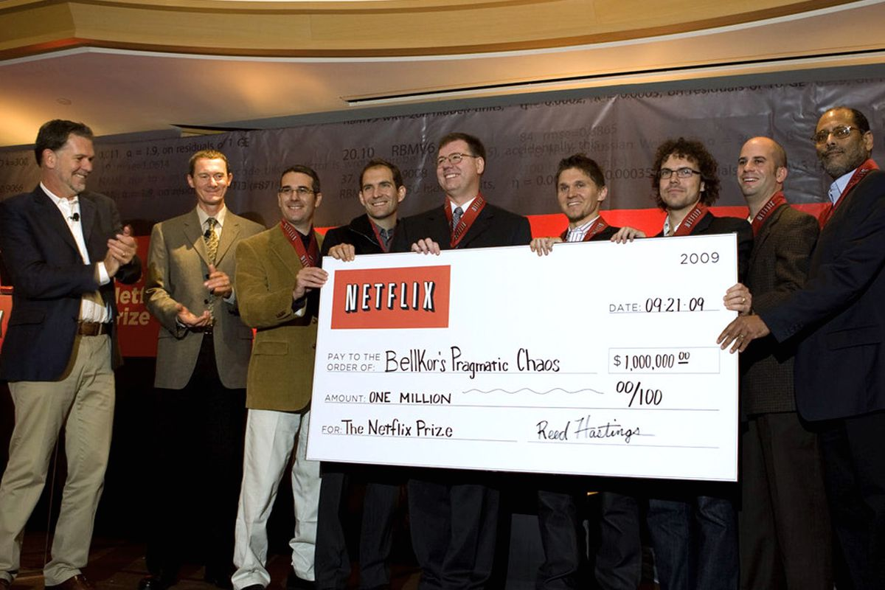
The Prize Goes To …
Once a team succeeded to improve the RMSE by 10%, the jury issue a last call, giving all teams 30 days to send their submissions.
On July 25, 2009 the team "The Ensemble” achieved a 10.09% improvement.
After some dispute …

Slide 12
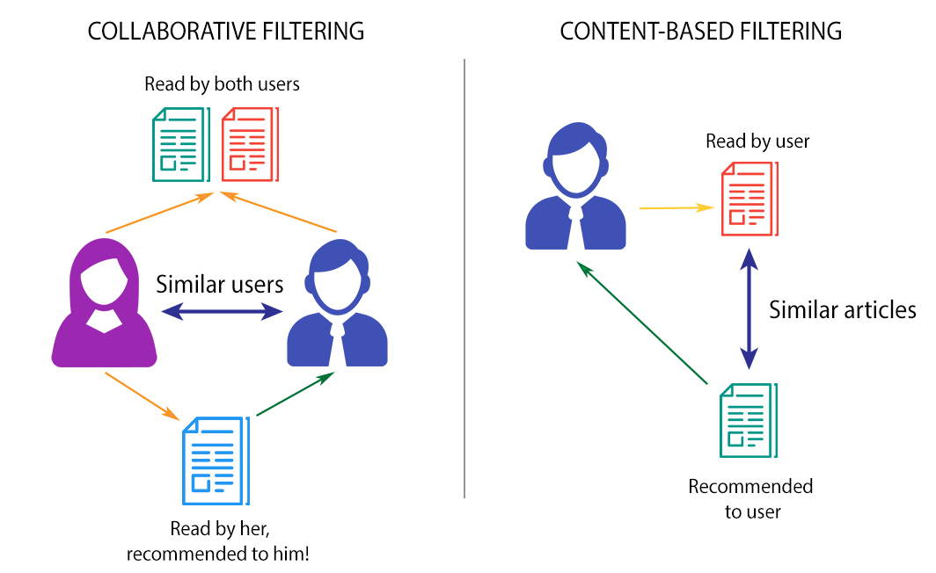
Approaches
Recommender systems can be loosely broken down into three categories:
content-based systems
collaborative filtering systems
hybrid systems
(a combination of the other two).

Slide 13
Approaches
Collaborative filtering approach builds a model from a user’s past behaviors (items previously purchased or selected and/or numerical ratings given to those items) as well as similar decisions made by other users.
This model is then used to predict items (or ratings for items) that the user may have an interest in.

Slide 14
Approaches
Content based approach utilizes a series of discrete characteristics of an item in order to recommend additional items with similar properties. Hybrid approach combines the previous two approaches. Most businesses probably use hybrid approach in their production recommender systems.

Slide 15
Collaborative Filtering
Collaborative Filtering is a mathematical method to find the predictions about how users can rate a particular item based on ratings of other similar users.
Typical Collaborative Filtering involves 4 different stages: Data Collection — Collecting user behaviors and associated data items Data Processing — Processing the collected data Recommendation Calculation — Calculate referrals based on processed data Result Derivation — Extract the similarity and return the top N results

Slide 16


Explicit and Implicit Feedbacks
Explicit Feedback is ratings given by users, which Netflix is collecting to make recommendations to their customers after they provide ratings to the movies they have watched.
Implicit Feedback is (less straightforward) based on the users’ interactions with the platform, ranging from clicks, views, likes and purchases. Spotify makes use of Implicit Feedbacks to implement it’s recommendation system.

Slide 17
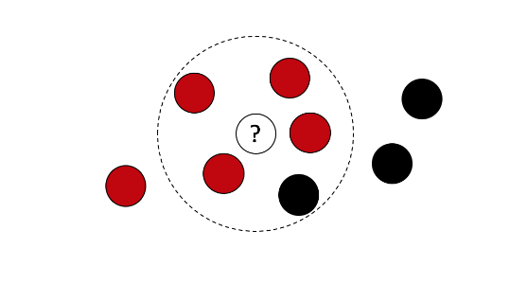
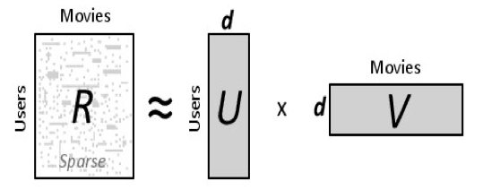
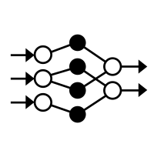
Collaborative Filtering Techniques
Nearest Neighbor (Pandas)
Matrix Factorization (Spark)
Deep Learning NN (Keras) – not here

Slide 18
Technique 1 – K Nearest Neighbors

Slide 19
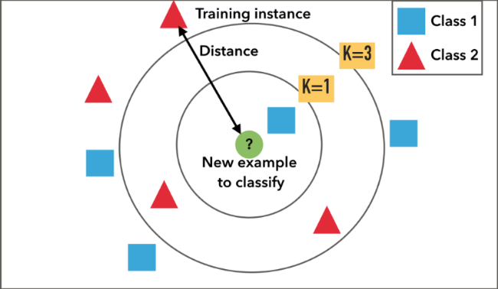
KNN item-Based Collaborative Filtering
KNN is a non-parametric, lazy learning method.
It uses a database in which the data points are separated into several clusters to make inference for new samples.

Slide 20
KNN item-Based Collaborative Filtering
When KNN makes inference about a datapoint, KNN will calculate the “distance” between the target and every other points in its database, then it ranks its distances and returns the top K nearest neighbor points as the most similar recommendations.

Slide 21
1-Nearest Neighbor

Slide 22
3-Nearest Neighbor

Slide 23
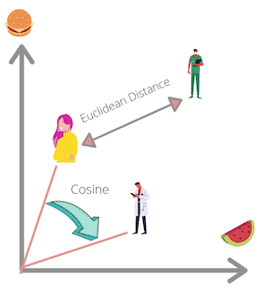
KNN item-Based Collaborative Filtering
How to find “close” items?
Euclidean distance - unhelpful in high dimensions because all vectors are almost equidistant to the search query vector
Cosine similarity - a measure of similarity between two sequences of numbers
Locality sensitive hashing – not here

Slide 24
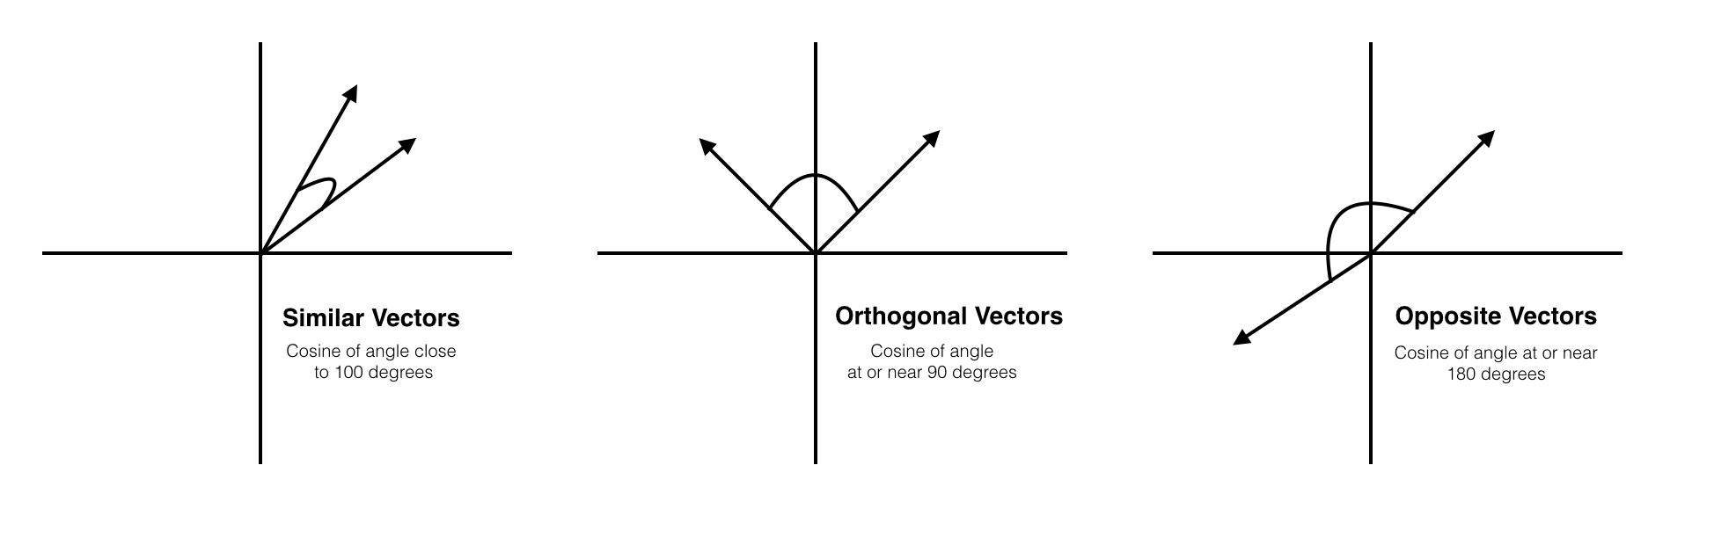

Cosine Similarity
$$Cosine\left(A,B\right)=cos⁡(θ)=\frac{A⋅B}{\left\|A\right\|⋅\left\|B\right\|}$$
$$A=\left(a_{1},a_{2},…, a_{n}\right), B=(b_{1},b_{2},…, b_{n}) \\ \left\|A\right\|=\sqrt{a_{i}^{2}+…+a_{n}^{2}} \\ \left\|B\right\|=\sqrt{b_{i}^{2}+…+b_{n}^{2}}$$

Slide 25

Cosine Similarity
$$Cosine\left(A,B\right)=cos⁡(θ)=\frac{A⋅B}{\left\|A\right\|⋅\left\|B\right\|}$$
$$A=\left(3,2,0,5\right) \\ B=(1,0,0,0)$$
$$A⋅B=3⋅1+2⋅0+0⋅0+5⋅0=3 \\ \left\|A\right\|=\sqrt{3^{2}+2^{2}+0^{2}+5^{2}}=6.164 \\ \left\|B\right\|=\sqrt{1^{2}+0^{2}+0^{2}+0^{2}}=1$$
$$Cosine\left(A,B\right)=\frac{3}{6.164⋅1}=0.486$$

Slide 26
Issue with the user-based kNN CF
The problem with the user-based formulation of collaborative filtering is the lack of scalability:
it requires the real-time comparison of the target user to all user records in order to generate predictions.
A variation of this approach that remedies this problem is called item-based CF.

Slide 27
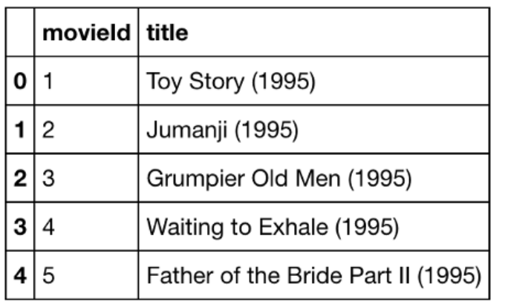
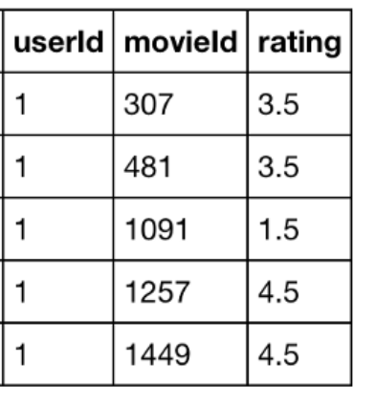
KNN item-Based Collaborative Filtering
MovieLens dataset contains 27,753,444 ratings and 1,108,997 tag applications across 58,098 movies. These data were created by 283,228 user and the ratings are on a scale from 1 to 5.
Movies Ratings

Slide 28
Introduction to Technique 2 – Matrix Factorization

Slide 29
Introduction
A common problem faced by internet companies is that of recommending new products to users in personalized settings
Amazon’s product recommender system
Netflix movie recommendations
Streaming Services
The key factor of recommending with big-data is Matrix Factorization.

Slide 30
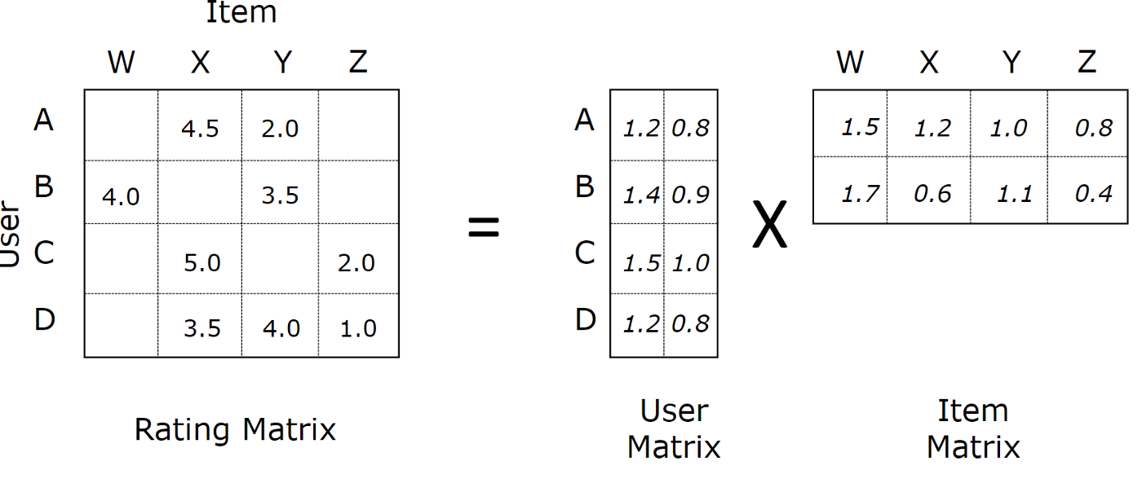
Matrix Factorization
A family of mathematical operations for matrices in linear algebra.
A factorization of a matrix into a product of matrices.
Matrix factorization algorithms work by decomposing the user-item interaction matrix into the product of two lower dimensionality rectangular matrices.

Slide 31
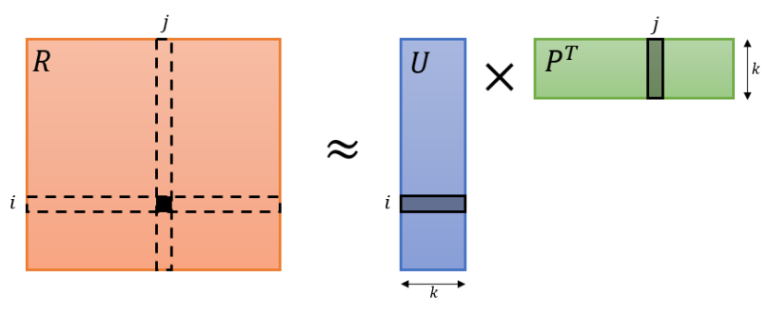

Matrix Factorization
Given matrix $R$ of ratings, factorize it into two matrices $U$ and $P$ such that $U^{T}P ≈R$.
(some versions are $UP^{T} ≈R$)

Slide 32
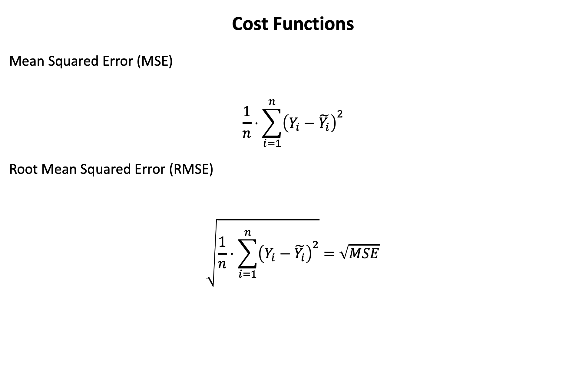
Cost Functions
Mean Squared Error (MSE)
$$\frac{1}{n}⋅\sum_{i=1}^{n}{{\left(Y_{i}−\tilde{Y_{i}}\right)}^{2}}$$
Root Mean Squared Error (RMSE)
$$\sqrt{\frac{1}{n}⋅\sum_{i=1}^{n}{{\left(Y_{i}−\tilde{Y_{i}}\right)}^{2}}}=\sqrt{MSE}$$

Slide 33
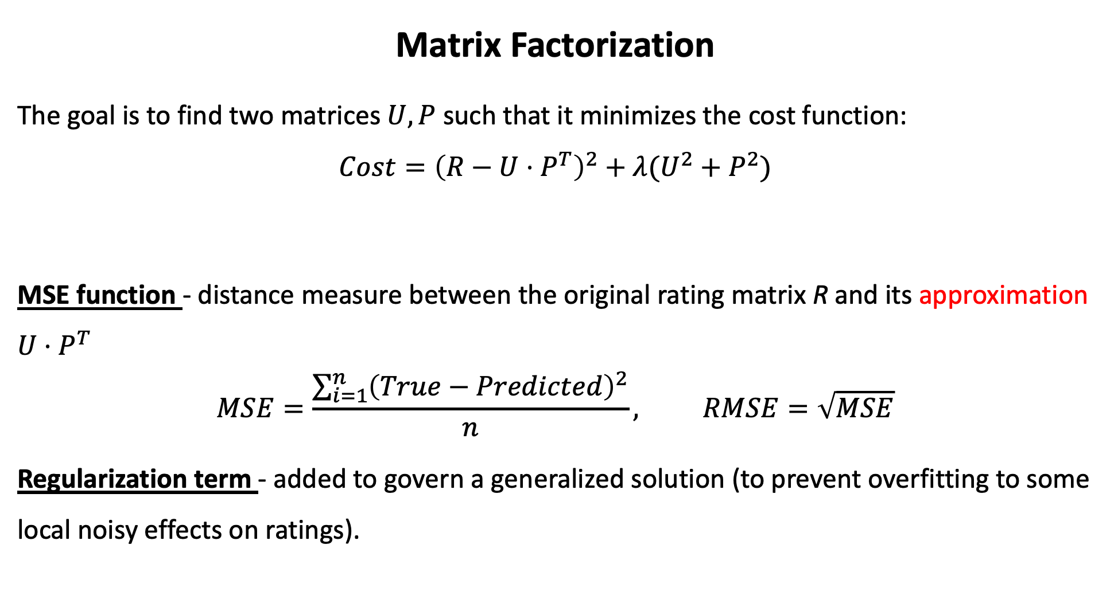
Matrix Factorization
The goal is to find two matrices $U,P$ such that it minimizes the cost function:
$$Cost={\left(R−U⋅P^{T}\right)}^{2}+λ(U^{2}+P^{2})$$
MSE function - distance measure between the original rating matrix R and its approximation $U⋅P^{T}$
$$MSE=\frac{\sum_{i=1}^{n}{{\left(True−Predicted\right)}^{2}}}{n}, RMSE=\sqrt{MSE}$$
Regularization term - added to govern a generalized solution (to prevent overfitting to some local noisy effects on ratings).
MSE Function
Regularization

Slide 34
Matrix Factorization
We want to minimize the cost function and the problem become an optimization problem.
This optimization problem is naturally solved by machine learning techniques:
Gradient Descent (not here)
Singular Value Decomposition (SVD)
Alternating Least Squares (ALS) - Approximation

Slide 35
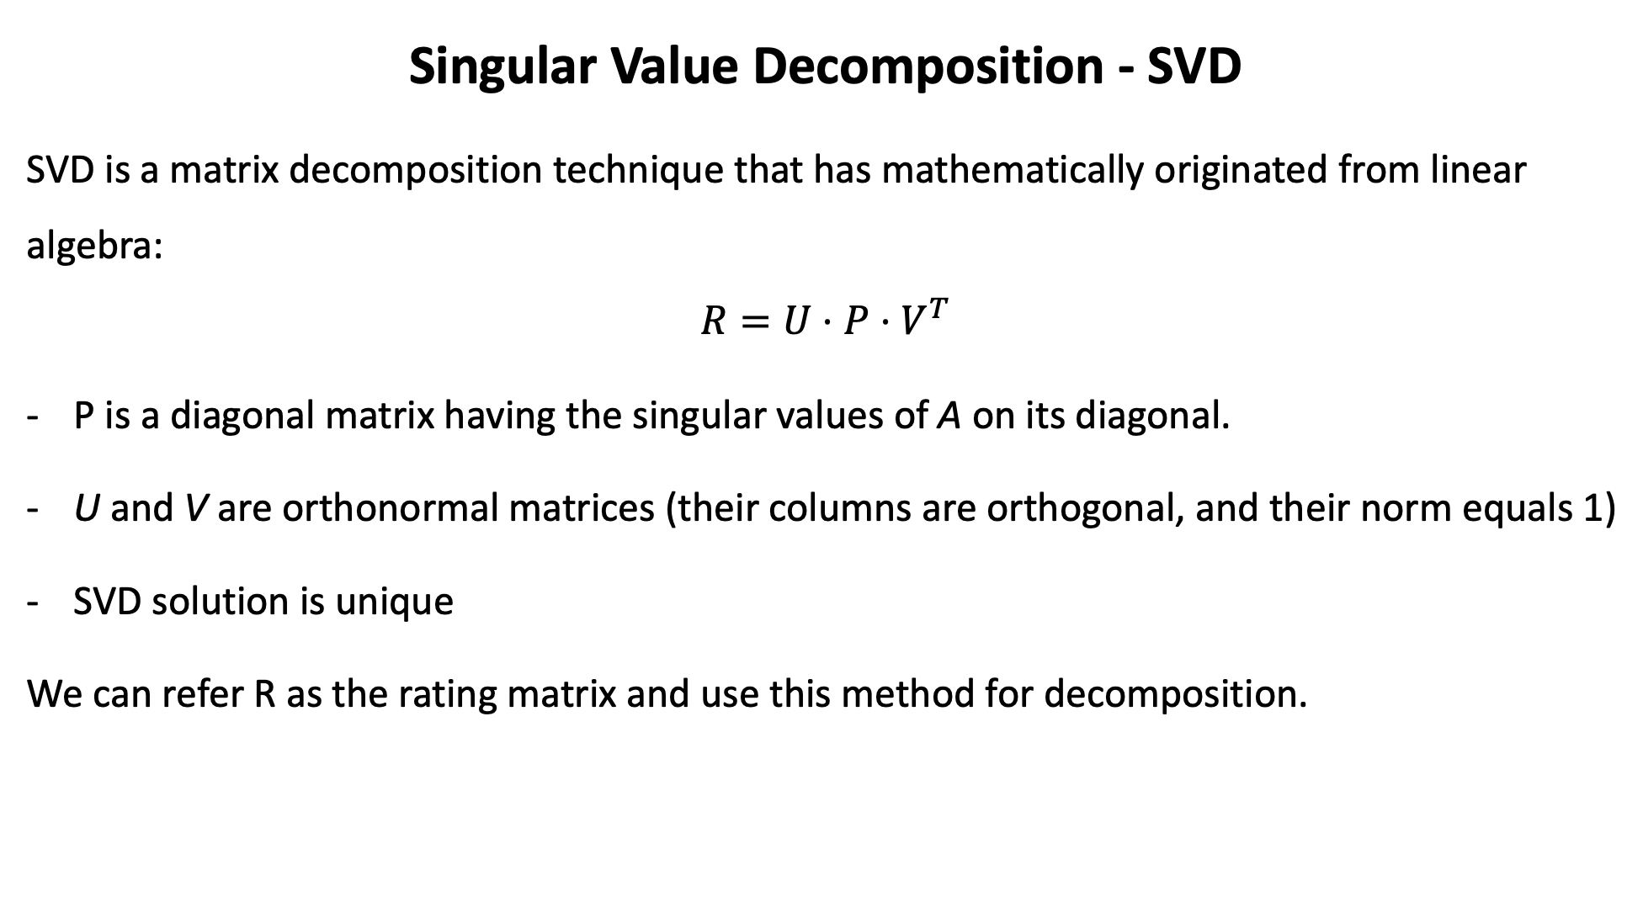
Singular Value Decomposition - SVD
SVD is a matrix decomposition technique that has mathematically originated from linear algebra:
$$R=U⋅P⋅V^{T}$$
P is a diagonal matrix having the singular values of A on its diagonal.
U and V are orthonormal matrices (their columns are orthogonal, and their norm equals 1)
SVD solution is unique
We can refer R as the rating matrix and use this method for decomposition.

Slide 36

Singular Value Decomposition - SVD
What׳s wrong?
High Computational Complexity
The original matrix must be fully dense (no missing values allowed)
This is not the case in most streaming and cloud services

Slide 37
Technique 2 – Matrix Factorization and ALS

Slide 38
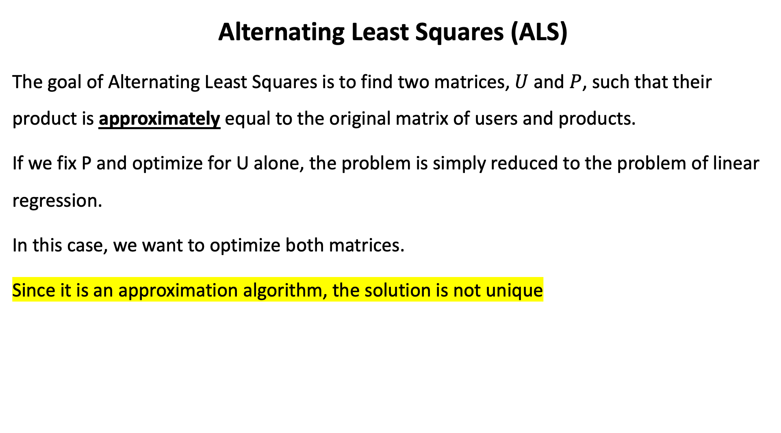
Alternating Least Squares (ALS)
The goal of Alternating Least Squares is to find two matrices, $U$ and $P$, such that their product is approximately equal to the original matrix of users and products.
If we fix P and optimize for U alone, the problem is simply reduced to the problem of linear regression.
In this case, we want to optimize both matrices.
Since it is an approximation algorithm, the solution is not unique

Slide 39

Alternating Least Squares (ALS)
The goal of Alternating Least Squares is to find two matrices, $U$ and $P$, such that their product is approximately equal to the original matrix of users and products.
Once such matrices have been found, we are able to predict what user $i$ will think of product $j$ by multiplying row $i$ of $U$ with row $j$ of $P$.
 | Product 1 | Product 2 | Product 3
User 1 | 0.5 | ? | 4
User 2 | 1 | 3 | 5

Slide 40
Alternating Least Squares (ALS)
Consider the following matrix which holds opinions of two users on three products:
We wish to be able to predict how user 1 will rate product two.
This is where Alternating Least Squares (ALS) comes in.
 | Product 1 | Product 2 | Product 3
User 1 | 0.5 | ? | 4
User 2 | 1 | 3 | 5

Slide 41
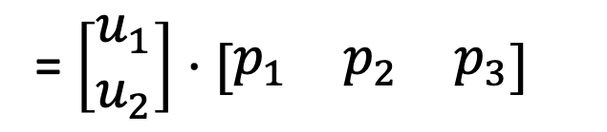
Computing U and P in ALS
The method is called “alternating” since the following two steps are repeated:
1. Fix matrix U and find the optimal matrix P
2. Fix matrix P and find the optimal matrix U
 | Product 1 | Product 2 | Product 3
User 1 | 0.5 | ? | 4
User 2 | 1 | 3 | 5
= $\left[\begin{matrix}u_{1} \\ u_{2}\end{matrix}\right]⋅[\begin{matrix}p_{1} & p_{2} & p_{3}\end{matrix}]$

Slide 42
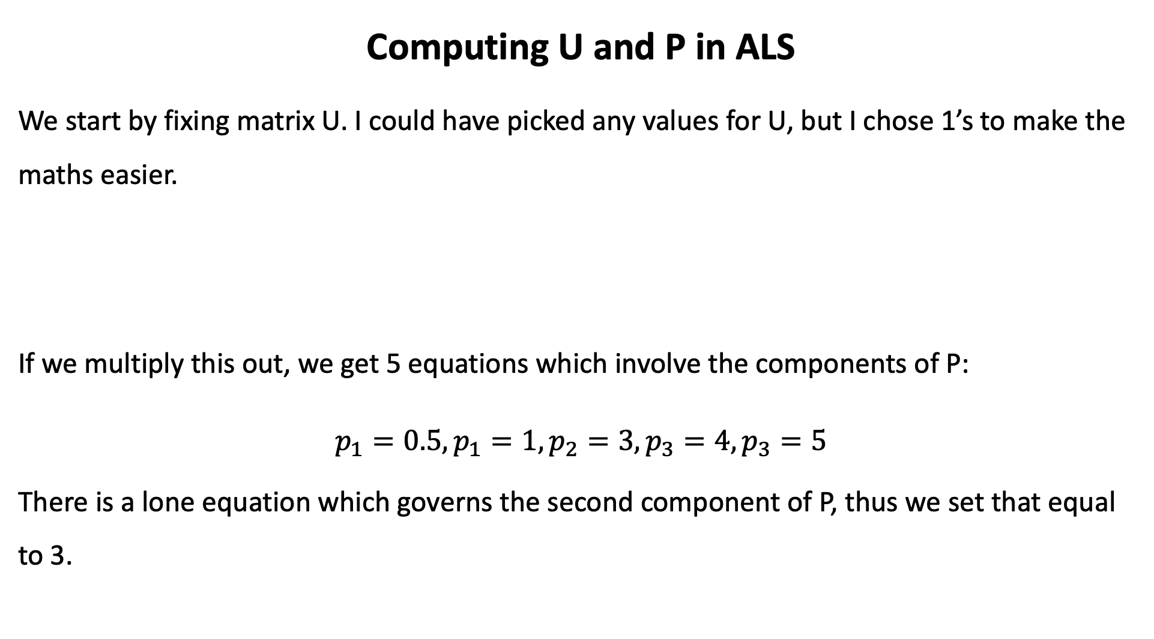
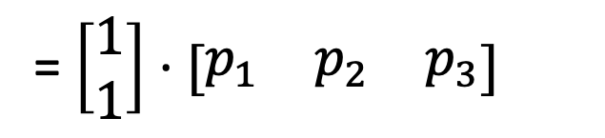
Computing U and P in ALS
We start by fixing matrix U. I could have picked any values for U, but I chose 1’s to make the maths easier.
If we multiply this out, we get 5 equations which involve the components of P:
$$p_{1}=0.5, p_{1}=1, p_{2}=3, p_{3}=4, p_{3}=5$$
There is a lone equation which governs the second component of P, thus we set that equal to 3.
 | Product 1 | Product 2 | Product 3
User 1 | 0.5 | ? | 4
User 2 | 1 | 3 | 5
= $\left[\begin{matrix}1 \\ 1\end{matrix}\right]⋅[\begin{matrix}p_{1} & p_{2} & p_{3}\end{matrix}]$

Slide 43
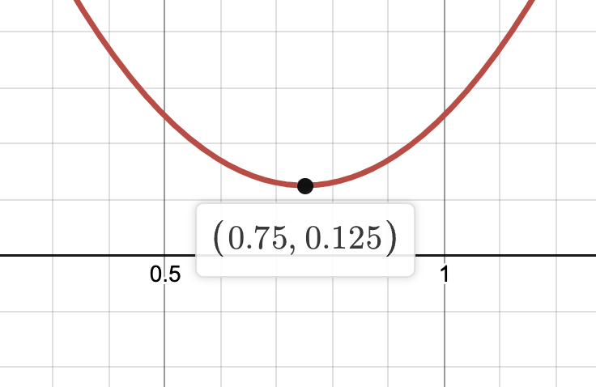

Computing U and P in ALS
We need to select the remaining two components such that the mean squared error is minimized:
$$p_{1}^{∗}={\left(0.5−p_{1}\right)}^{2}+{\left(1−p_{1}\right)}^{2}=2p_{1}^{2}−3p_{1}+\frac{5}{4}$$
What minimize $p_{1}^{∗}$?
$$\frac{∂p_{1}^{∗}}{∂p_{1}}=4p_{1}−3=0 \\ p_{1}=0.75$$

Slide 44
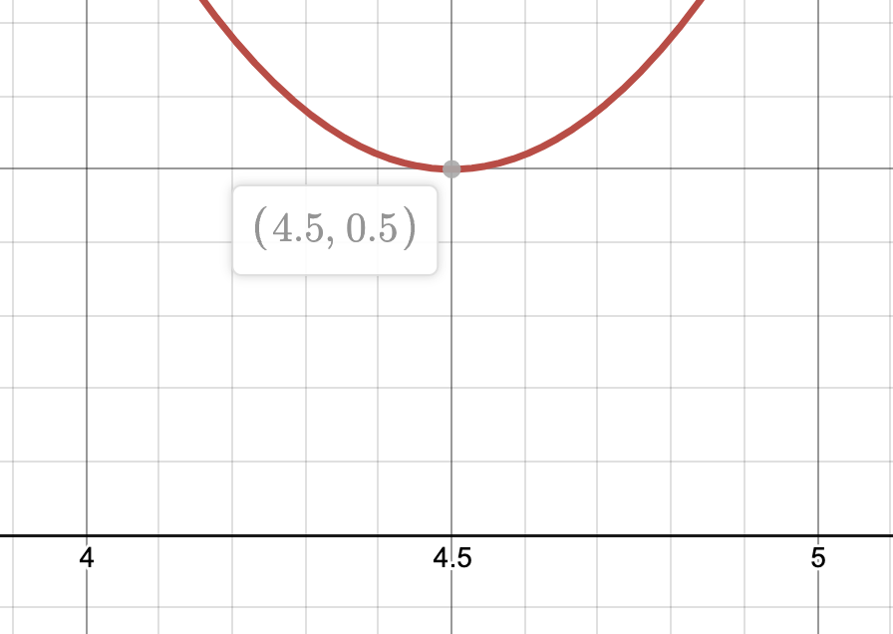

Computing U and P in ALS
We need to select the remaining two components such that the mean squared error is minimized:
$$p_{3}^{∗}={\left(4−p_{3}\right)}^{2}+{\left(5−p_{3}\right)}^{2}=2p_{3}^{2}−18p_{3}+41$$
What minimize $p_{3}^{∗}$?
$$\frac{∂p_{3}^{∗}}{∂p_{3}}=4p_{3}−18=0 \\ p_{3}=4.5$$

Slide 45
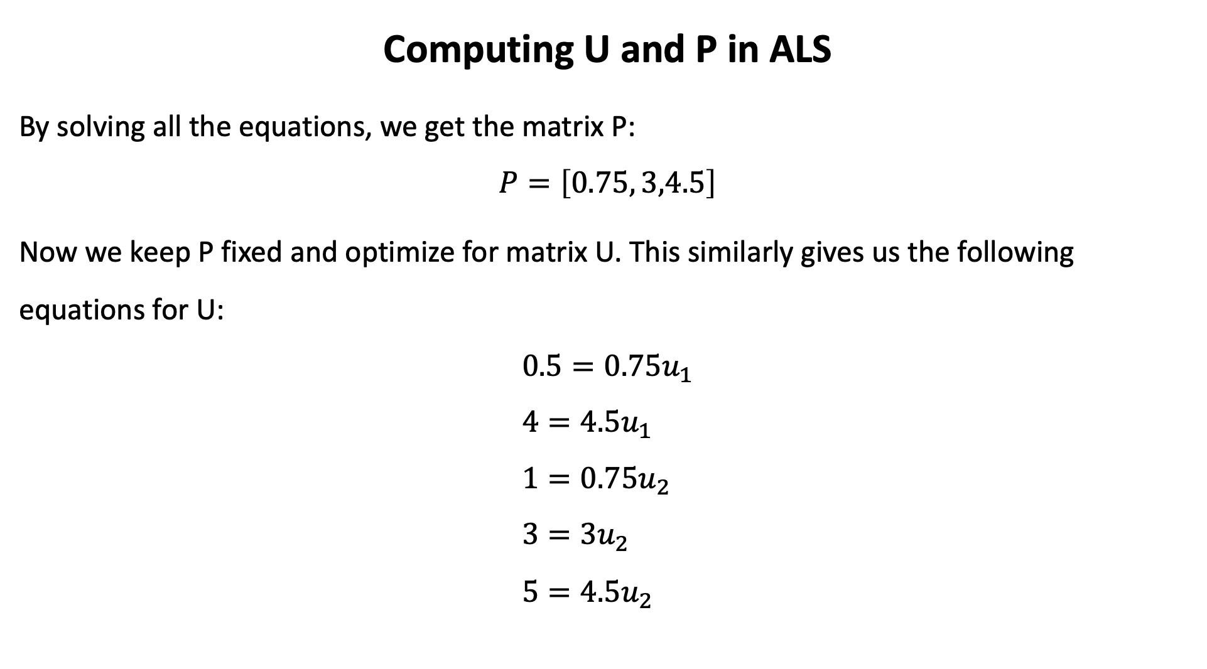
Computing U and P in ALS
By solving all the equations, we get the matrix P:
$$P=\left[0.75, 3,4.5\right]$$
Now we keep P fixed and optimize for matrix U. This similarly gives us the following equations for U:
$$0.5=0.75u_{1} \\ 4=4.5u_{1} \\ 1=0.75u_{2} \\ 3=3u_{2} \\ 5=4.5u_{2}$$

Slide 46
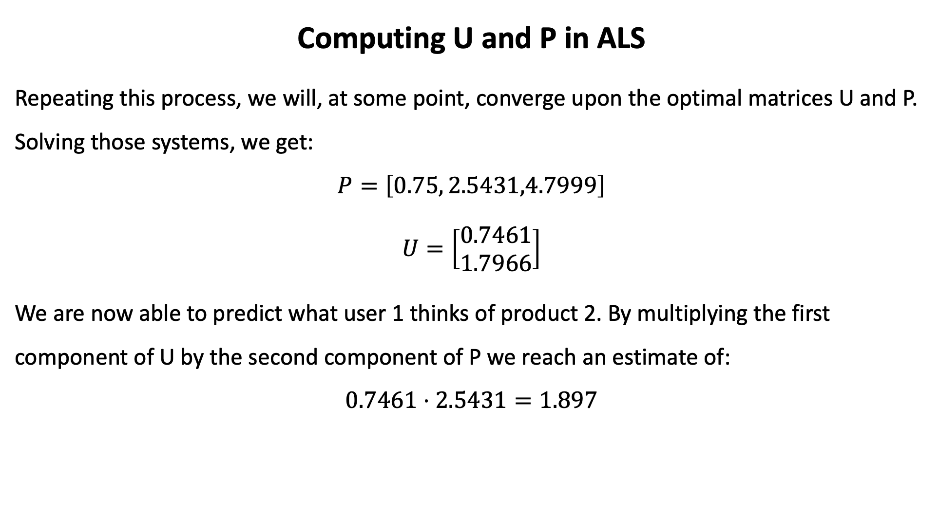
Computing U and P in ALS
Repeating this process, we will, at some point, converge upon the optimal matrices U and P. Solving those systems, we get:
$$P=\left[0.75, 2.5431,4.7999\right]$$
$$U=\left[\begin{matrix}0.7461 \\ 1.7966\end{matrix}\right]$$
We are now able to predict what user 1 thinks of product 2. By multiplying the first component of U by the second component of P we reach an estimate of:
$$0.7461⋅2.5431=1.897$$

Slide 47
How to Build Collaborative Filtering using ALS?
Step 1: Load data
Step 2: Split data into train, validation and test sets.
Train - The sample of data used to fit the model.
Validation - The evaluation becomes more biased as skill on the validation dataset is incorporated into the model configuration. (“semi-testing” your model)
Test - The sample of data used to provide an unbiased evaluation of a final model fit on the training dataset.

Slide 48
How to Build Collaborative Filtering using ALS?
Step 3: ALS Model Selection
To find the optimal hyperparameters, use grid search and select the best model.
Step 4: Learning Curve
As we increased number of iterations in training ALS, we can see how RMSE changes and whether model is overfitted. Step 5: Make recommendations ☺

